Slide 1

U S Census Bureau
Complete Count Committee(CCC)
Training Workshop
June 20, 2019
10:00 AM – 12:00 PM

Slide 2
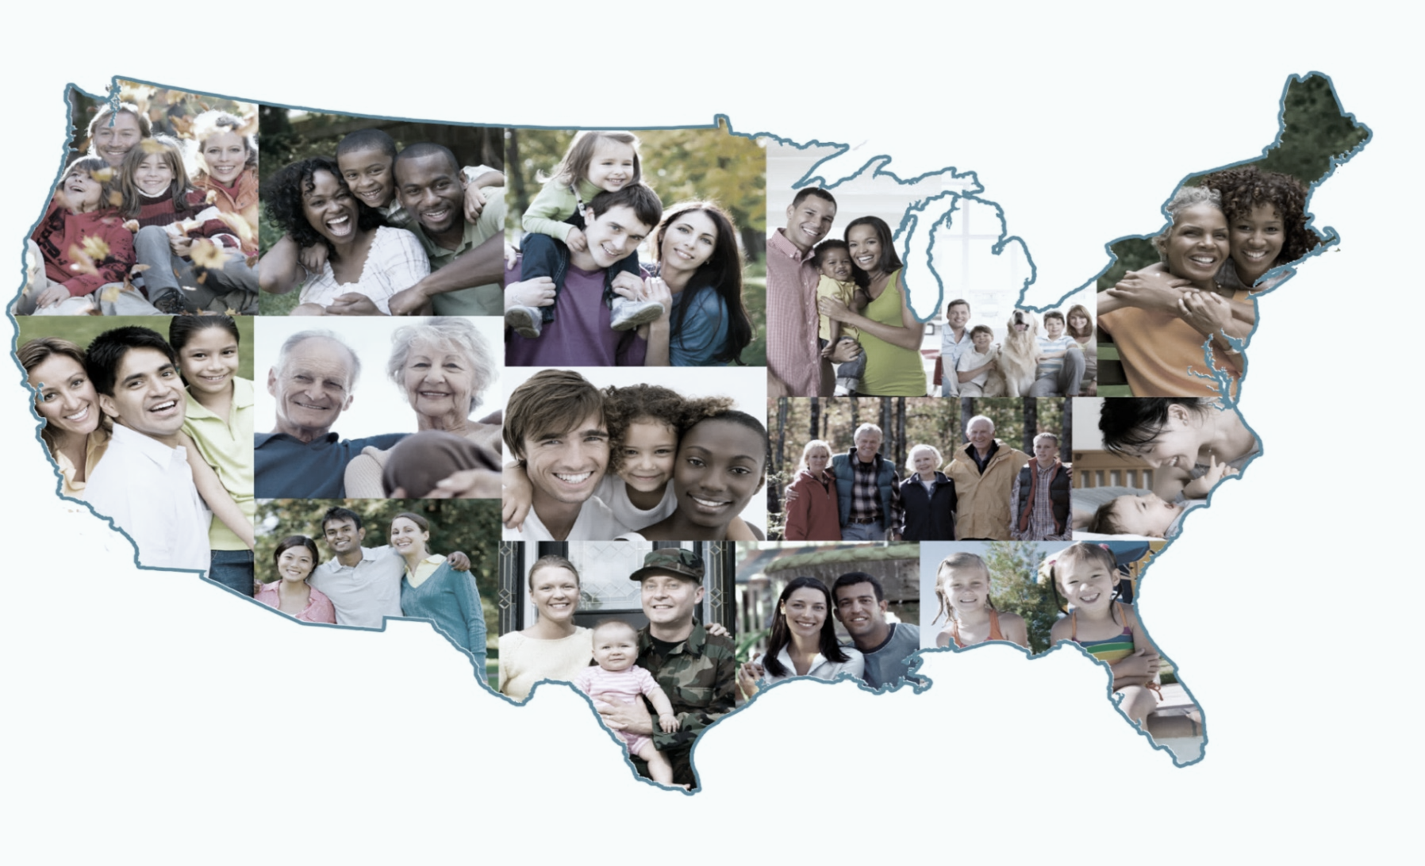
Forming 2020 Census Complete Count Committees
Atlanta Regional Office
Managing Census Operations in
AL, FL, GA, LA, MS, NC, SC

Slide 3
The goal of Census 2020 is to count everyone once,
only once and in the right place.
EVERYONE COUNTS!

Slide 4
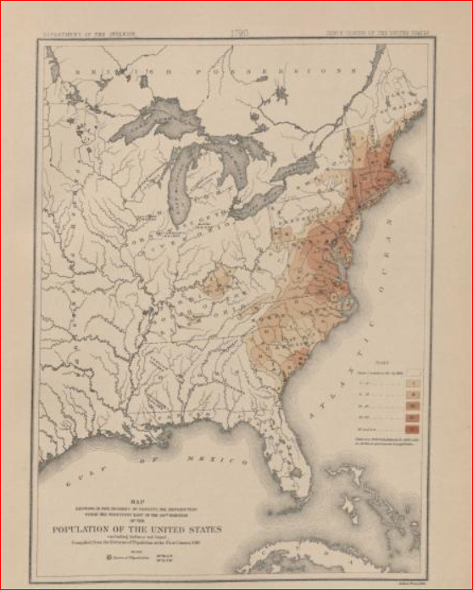
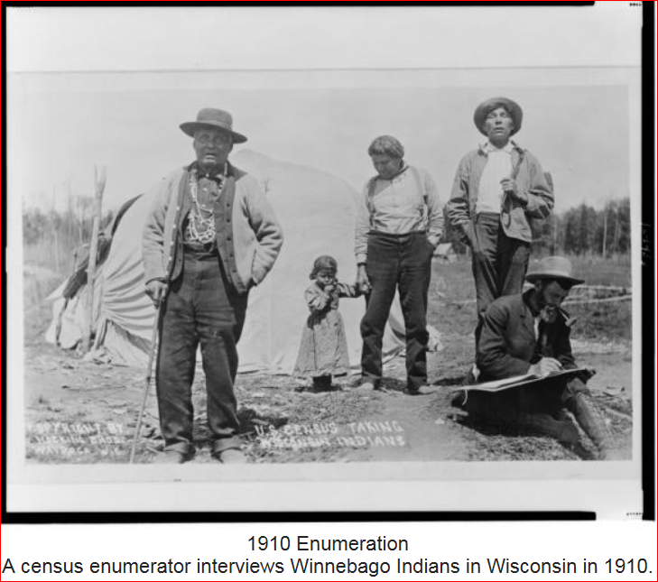
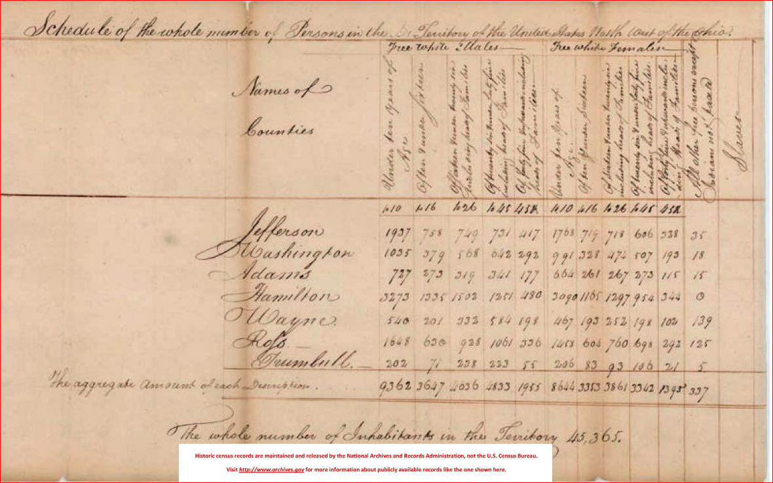
The U.S. Constitution and Decennial Census
Conducted every 10 years since 1790, as required by the U.S. Constitution. Article I, Section 2. "Representatives and direct Taxes shall be apportioned among the several States which may be included within this Union, according to their respective Numbers . . .
The 1790 counted 3.9 million inhabitants.
U.S. marshals conducted the enumerations between 1790 and 1870.
Specially trained enumerators carried out the census beginning in 1880.

Slide 5
Why We Ask You to Allocate Resources to the 2020 Census
Political Power
  Census is constitutionally mandated for re-apportionment of Congress
  Census results are used for Redistricting at national, state, and local levels.
Money/Economic Impact
  Over $675 Billion/year is distributed to state and local governments using Census numbers (Over $4 Trillion over the decade).

Slide 6
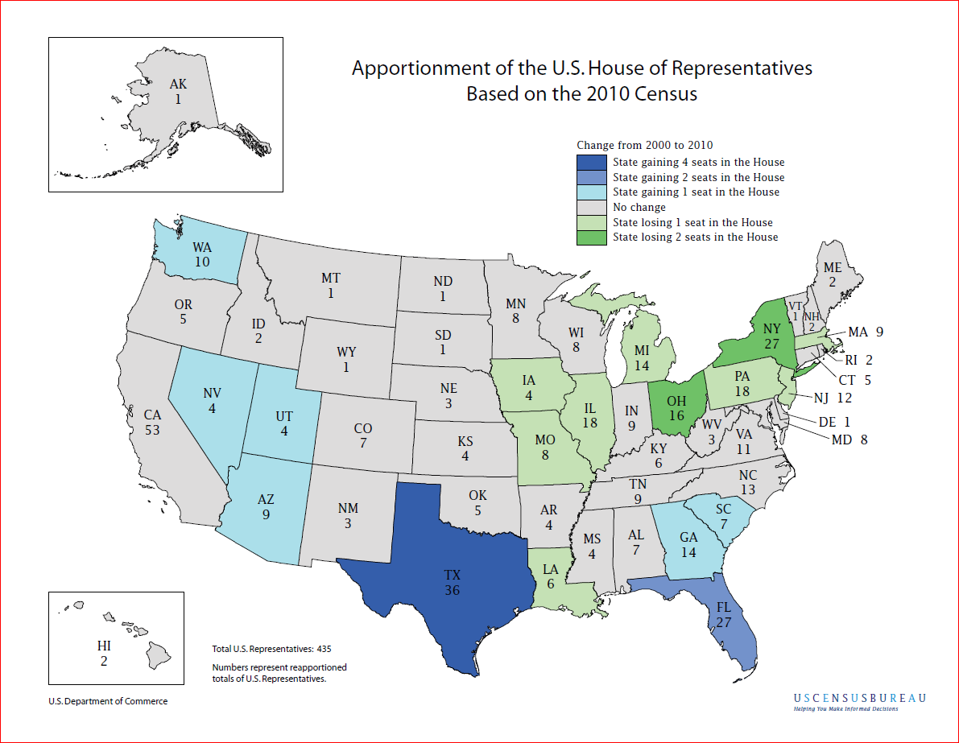
Notes:
As result of the population Count in 2010, the 2 of the states – GA and SC gained 1 Congressional seat, Florida gained 2 congressional seats, AL and MS stayed the same, while Louisiana lost one seat.

Slide 7
Bladen County and North Carolina
2000 & 2010 Census Participation Rates
2000 2010
North Carolina 69% 76%
Bladen County 46% 69%

Slide 8

Target Populations
Children 5yrs and under
Veterans
People with disabilities
Homeless
People living in rural America
Low income and underserved
Senior citizens
Migrant farm workers
Foreign Born - Immigrants
Persons with limited English proficiency
Renters

Slide 9
Census Data Are Used In Many Ways
    Forecasting of future transportation needs
    Determining areas eligible for housing assistance and rehabilitation loans
    Assisting tribal, federal, state and local governments in planning, and implementing programs and services in:
      Education
      Healthcare
      Transportation
      Social Services
      Emergency response
    Designing facilities for people with disabilities, the elderly and children

Slide 10

Privacy and Confidentiality
Under Title 13, U.S. Code, all Census Bureau employees swear a lifetime oath to protect respondent data. It is a felony for any Census Bureau employee to disclose any confidential census information during or after employment, and the penalty for wrongful disclosure is up to 5 years imprisonment and/or a fine of $250,000.
We protect information by taking precautions in how we collect, analyze and disseminate information. The Census Bureau has strong program to protect information as they collect, process and store it in secure IT systems.
The Census Bureau encrypts information, limits access, and actively monitors systems to make sure information stays secure.

Slide 11
It is important to note that the Census Bureau:
never asks for your full Social Security number;
never asks for money or a donation;
never sends requests on behalf of a political party;
never requests PIN codes, passwords or similar access information for credit cards, banks or other financial accounts.

Slide 12
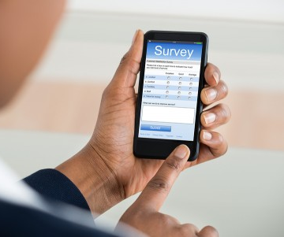
New Initiatives for Census 2020
Allowing people to respond anytime, anywhere, via phone or internet. Tests have shown internet self-response is the most cost effective and accurate way. Those that request a form can complete the Census using the form.
The Census Bureau is eliminating paper and incorporating the use of handheld data collection devices.

Slide 13
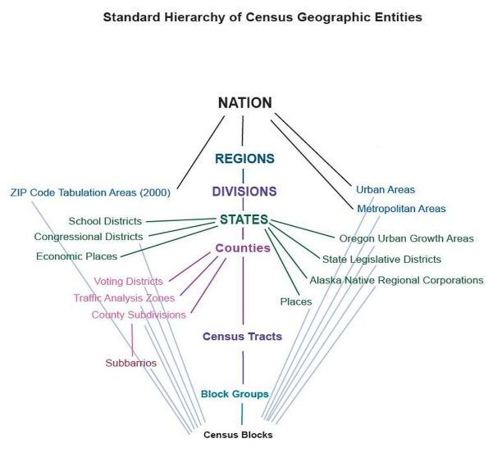

Did Do You know that the Census Bureau Collects a
Wide Variety of Data Every Month?
Demographics:
Age
Sex
Marital
Education
Housing
Health Ins and more
Business and Industry Data
Import/Exports
Employment
Government Data
Data at a variety of Geographic Levels:
National, State, County
City/Place
Tract
Block
Congressional Districts

Slide 14
Complete Count Committees
Ultimately, the success of the 2020 Census depends on everyone’s participation. One way to ensure success is by forming a Complete Count Committee.
State and local governments, businesses and community leaders form Complete Count Committees to encourage participation in their community. They develop an outreach plan tailored to the unique characteristics of their community. Then they work together to implement the plan.

Slide 15

Complete Count Committees
  Complete Count Committees conduct a wide range of possible activities. For example, they host promotional events, display census information in government buildings, include census messages on customer billing statements or other correspondence, and they network with community leaders to ensure everyone is involved.
  Opportunity to “tailor” the Census outreach and messaging to most effectively influence local communities.
  Involve all constituent groups, and use “trusted voices” of community leaders to encourage self-response.

Slide 16
Get Organized Right NOW!
Households will begin to experience, by the end of 2018, some type of census operation such as address listing. These necessary operations verify the accuracy and location of each address.
The immediate formulation of a CCC will ensure that local households are kept abreast of the various census operations before the information is nationally circulated.
The more informed households are about the 2020 Census operations, the better their understanding of the census process becomes, thus increasing their willingness to be a part of the successful enumeration in 2020.

Slide 17
What is the Structure of a CCC?
Highest elected officials or community leaders appoint chairpersons
The Chairperson is the liaison or main source of contact between the CCC and the Census Bureau
The chairperson collaborates with the highest elected official or community leader to select subcommittees and chairs of the subcommittees

Slide 18
CCC Chairs and Subcommittee Chairs
Choose a CCC committee chairperson who is committed, knowledgeable, and active in the community
Select subcommittee chairpersons who are purpose-driven, result oriented, and get results
Customize and design the committee to reflect a true snapshot of the community
Include diverse perspectives to achieve objectives. Assess which groups—locally and nationally—are able to provide support and assistance
Include Trusted Voices

Slide 19
Subcommittee Examples
Government
Education
Faith-based
Media
Business
Community-based organizations
Recruiting
Housing
Senior Citizens
Philanthropic

Slide 20

Local Government CCC’s
Local government CCC’s should include members with experience in the following areas:
  Government
  Education
  Media
  Minority Organizations
  Community organizations
  Workforce developments
  Faith-based institutions
  Businesses

Slide 21

Community-based CCC’s
The Census Bureau encourages community leaders in hard-to-count areas to form CCC’s and include trusted voices from the community.
Hard-to-count areas may, for example, have:
  • Hidden or overcrowded housing
  • Populations that speak little or no English
  • Off-campus apartments
  • New immigrant populations
  • High poverty areas
  • People displaced by natural disasters such as
  floods, fires, and hurricanes

Slide 22
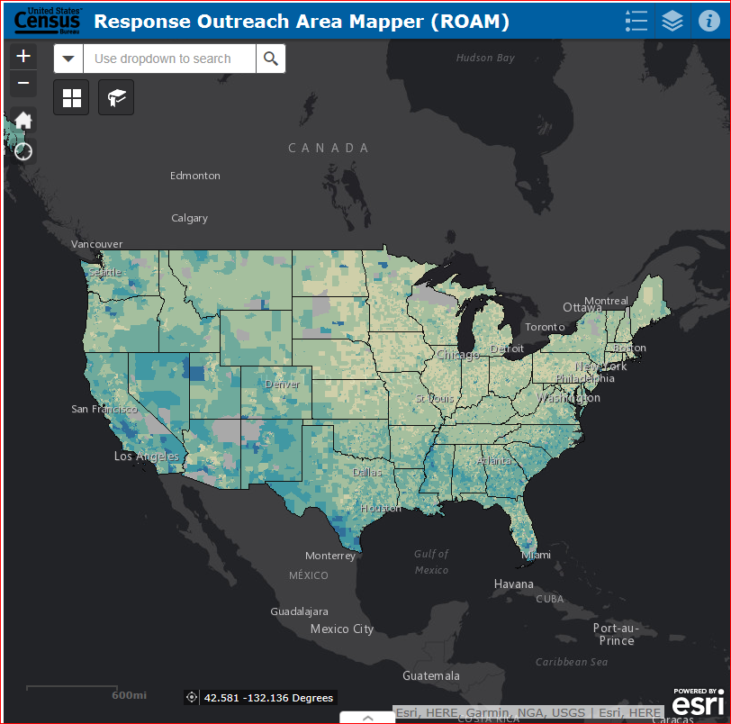
Explore the Response Outreach Area Mapper Web Application
The U.S. Census Bureau has released the Response Outreach Area Mapper (ROAM) web application.
An interactive map to identify areas that typically have low response rates for censuses and surveys.
Community planners and local officials can use the ROAM to plan, focus and allocate resources for the 2020 Census.
Provides tract-level data.

Slide 23

Subcommittee Worksheet
Take a moment to brainstorm
Think about trusted voices
Think about organizations that have an impact and serve
Think about areas that may be hard to count and identify leaders or trusted voices in those communities

Slide 24

How the Census Bureau Will Support You
We will provide staff from our regional offices to work directly with each Complete Count Committee.
We will provide information, assist you in forming committees and subcommittees, and participate in local events and activities.
We plan to provide a guide for 2020 Census Complete Count Committees, but you can begin now. In the meantime, you can refer to a Complete Count Committee guide and other information available online from the 2010 Census for historical reference. Keep a big change in mind though: we’ll primarily ask people to respond to the 2020 Census online (not by mail).
As the 2020 Census gets closer, the Census Bureau will also launch a robust communications campaign. We’ll use advertisements, conduct outreach. You can leverage our efforts in your own community through your Complete Count Committee.

Slide 25

Prepare for 2020 Census, Now!
Create or join a Complete Count Committee and partner with other trusted voices and influential leaders in your area who are committed to increasing census participation. Encourage your peers to get involved too. Call the Atlanta Regional Office to schedule a CCC Workshop.
Raise awareness by including census information in newsletters, social media posts, podcasts, mailings, and on Web sites.
Help recruit census workers when jobs become available.

Slide 27
WHO
DO
WE
NEED?

Slide 28
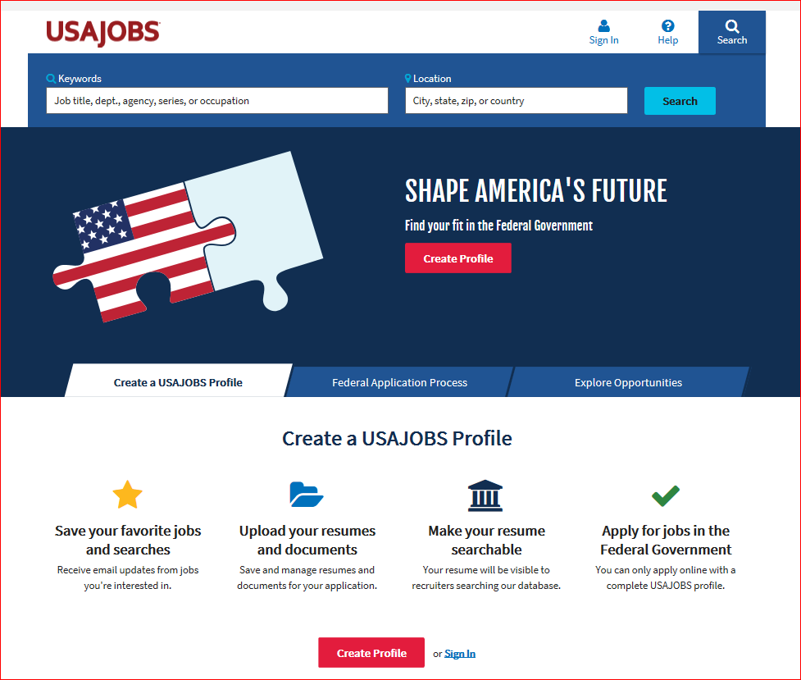
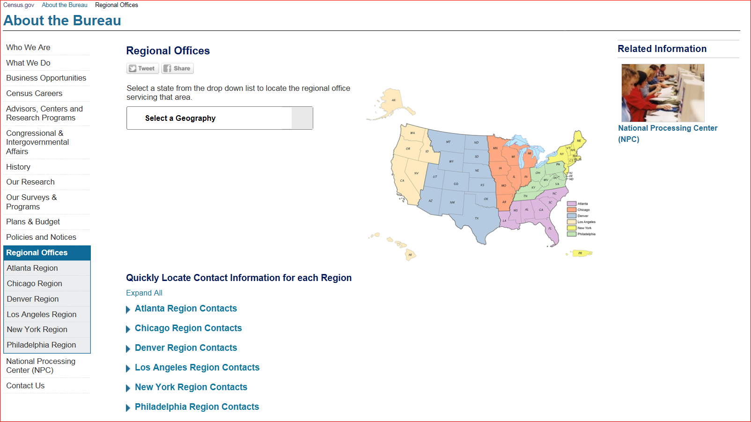
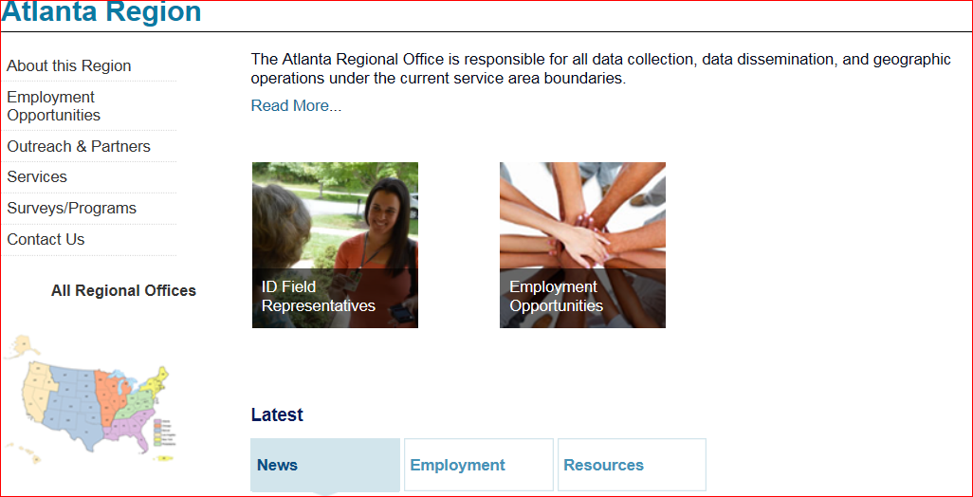
Sources for Job Information
Regional Offices & National Processing Center
USAJOBS.GOV
https://census.gov/about/regions/atlanta.html
Click on Employment Opportunities

Slide 29

Next Steps
Continue to finalize your list of CCC members
Inform the Census Bureau Partnership staff of the selected Chairperson, Committee members, Subcommittee chairpersons and members
Schedule a Census workshop on CCC Workplans and Strategies.

Slide 30

Contact Information:
Atlanta Partnership Staff (404) 730-3834
atlanta.rcc.partnership@census.gov
Atlanta Recruiting 1-855-889-8932
atlanta.rcc.recruiting@census.gov
Demorrio U. Thomas (678) 641-9782
Partnership Specialist
demorrio.u.thomas@2020census.gov
Kenneth C. Wilkins (678) 733-2569 Partnership Specialist
kenneth.c.wilkins@2020census.gov

